Slide 1
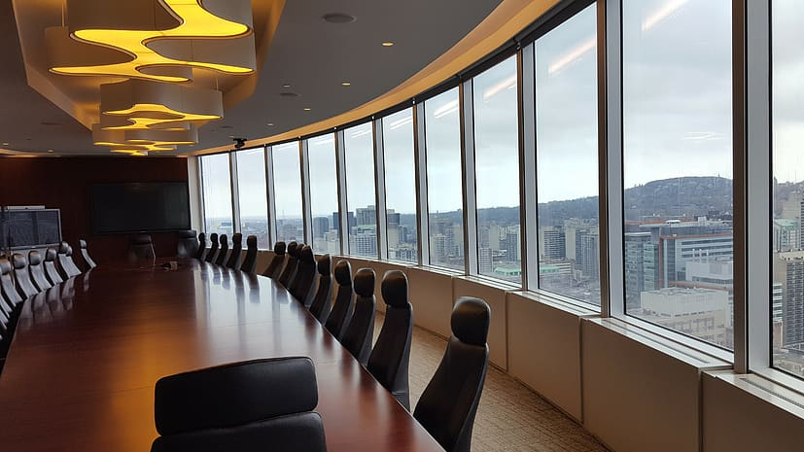
Heading back to the office?
Discussion points & resources for planning your return
Wednesday October 06, 2021
6:00 – 7:00pm

Slide 2
Navigating a Return to the Office
Schedules & workflows
MOVEMENT & Physical ACTIVITY
Group communication & Socialization
commuting, childcare
& other concerns

Slide 3
Schedules & workflows
What's on Offer?
Routines
Taking a Break
Provide common ground & goals
Support productivity & results

Slide 4
What's on offer?
Full-time in office?
Hybrid work schedule?
Office location change?
Changed schedule or total hours?
Changed position or work groups?
Transition timeline and plan?
New business systems?
Workplace safety plans?
Access to Counselling?
Do you have open communication with/from decision makers?
Understanding what you're returning to
Nobody is doing it best. We’re all figuring it out as we go along.
- Patty McCord, served as chief talent officer at Netflix for 14 years.

Slide 5
Routines Provide structure & predictability
How are your routines affected?
What stressors are eliminated or added by the changes?
Evaluate your previous routines:
What has since lapsed?
Were they productive or just comfortable?
Evaluate your current routines:
Will they be helpful to carry forward?
Are you gonna have to pick up your socks?! Shower?
Plan for the future honestly.
What is achievable now, and over time?
Communicate goals & ask for support if it helps.
Be flexible and follow the K.I.S.S Rule!
Often anxiety and stress is triggered by uncertainty and unpredictability and routine gives us that structure and predictability.” - Dr. Saunia Ahmad

Slide 6
Taking a break
Body Break
Breathe
Stretch
Walk
Rehydrate
Look at something other than a screen
Get out of your chair!
Brain Break
Breathe
Humour
Change of scenery
Book or Hobby

Slide 7
Movement & physical activity
Assessing
Ergonomics
Taking a break
Reintroducing our bodies to office life

Slide 8
assessing Provides answers/solutions & benchmarks
Will your current activity levels increase or decrease?
Can you incorporate exercise/stretching into your workday?
Are there movements specific to your job that you have not performed for a while? Can you prepare for this change?
How are you work desk ergonomics?
Has anything changed in the office set-up or your body?
How can your employer assist you?
Remember to take breaks!

Slide 9
Group communication & socialization
Small Talk, Big Talk
Boundaries
Virtual or In-Person?
Shifts in Dynamics

Slide 10
Elvis has returned to the building viva in-Person interactions – or not?
Sense of belonging or source of anxiety?
Ice breakers
Start local, with like minds and/or with small groups
Accept that there could be a change in dynamics
Continue with virtual meetings in the office
Set boundaries
between work and home life
topics of conversation – small talk/big talk
health safety
Give yourself and others time to adjust
I miss my shoes…I can’t be the only one who feels that way.
- Karg or Kelley Loughrey

Slide 11
Commuting, childcare & other concerns
Planning and Back-up Plans
Asking
Budgeting
Helpful Habits
The only requirement is that you stop trying to be so good.
– Christine Carter

Slide 12
Sharing, learning, rewarding*
ARMA VI
Colleagues
Coworkers
Human Resources
Other Offices
Businesses you support or use
Family & Friends
Pets!
Fitness Instructor
Financial Advisor
Spiritual Leader
Bus Buddies or Coffee Mates
Library
Nature
Online Forums
Hobby/Interest Groups
Sensory Stimulation
Prizes!

Slide 13
What we're learning as we go...
Don't be surprised if you feel homesick or nostalgic for previous routines.
It is ok to feel some sense of loss. – Dr. Renee A. Exelbert, PHD
Use positive language and motivation: frame ’changes as adaptions’, or ‘problems as challenges or learning experiences’.
Is it really a ‘Fail’?
Try intention management instead of time management. – Theresa Glomb, Professor at the University of Minnesota Carlson School of Management
If you are always trying to be normal, you will never know how amazing you can be. – Maya Angelou

Slide 14
Resources
Transition Tips
CTV News: https://www.ctvnews.ca/lifestyle/stressed-about-returning-to-in-person-work-experts-offer-tips-on-how-to-make-the-transition-easier-1.5451474
Grand Forks Herald: https://www.grandforksherald.com/business/workplace/7117371-Heading-back-to-the-office-after-working-from-home-during-the-pandemic-Here-are-some-tips-for-adjusting
CNN Business: https://www.cnn.com/2021/04/21/success/socializing-office-return-to-work/index.html
Cleveland Clinic: https://health.clevelandclinic.org/returning-to-work-soon-here-are-some-ways-to-make-the-process-easier/
verywellmind: https://www.verywellmind.com/going-back-to-the-office-after-the-pandemic-5180873
Ergonomics
WorkSafeBC: https://www.worksafebc.com/en/health-safety/hazards-exposures/ergonomics
Bucks Country Courier Times: https://www.buckscountycouriertimes.com/story/news/2021/07/29/employees-remote-workplace-ergonomic-bucks-montgomery-pennsylvania-covid-19-jobs-virtual/7653289002/
Camosun College: https://camosun.ca/covid-19/employee-resources
University of Victoria: https://www.uvic.ca/hr/home/working-remotely/rwa-faqs/index.php
B.C.’s Response to COVID-19: https://www2.gov.bc.ca/gov/content/covid-19/info/response
TED Talks
The 1-minute secret to forming a new habit – Christine Carter: https://www.youtube.com/watch?v=EvGkSEuWtaI
4 lessons the pandemic taught us about work, life balance - Patty McCord: https://www.ted.com/talks/patty_mccord_4_lessons_the_pandemic_taught_us_about_work_life_and_balance?language=en
Sara Wegwitz Presentation – visualization techniques, key communication skills, patience ☺

