Slide 1
‘Fun’ In ‘Functional’ Factors in the Acceptance of EDRMS
Weimei Pan
School of Library, Archival and Information Studies (iSchool)
University of British Columbia
ARMA Vancouver Island and Government Records Services, Shared Services BC
October 8, 2015

Slide 2
Agenda
Brief Overview of ‘Fun’ in ‘Functional’ Project
Data Collection
Preliminary Findings
Questions and Answers

Slide 3
Agenda
Brief Overview of ‘Fun’ in ‘Functional’ Project
Data Collection
Preliminary Findings
Questions and Answers

Slide 4
Putting the ‘Fun’ in ‘Functional’
This research looks at trust relationships from the perspective of the creators and internal users of organizational information/records and relevant systems/technologies.
Understanding how people engage with the information they create/use to accomplish their work in networked environments.
Goal is to improve relationships by positively influencing the way in which individuals perceive their work practices and the tools they use to accomplish them.
Explores some of the socio-technical factors that appear to affect the management of written and non-written information in organizations.

Slide 5
Research Questions
How do users interact with information systems in the different stages of adoption (initial introduction, adjustment to the system, continued use, etc.)?
How do users perceive the different functions of information systems in relation to their own personal information management?
What are users’ opinions on introducing gamification elements into information systems?

Slide 6
Literature Review
Game Studies & Gamification
Personal Information Management
Human-Technology Interaction

Slide 7
Agenda
Brief Overview of ‘Fun’ in ‘Functional’ Project
Data Collection
Preliminary Findings
Questions and Answers

Slide 8
Data Collection: Site
City of Toronto
Toronto Meeting Management Information System (TMMIS)
BC Government
EDRMS

Slide 9
Data Collection: Participants

Slide 10
Agenda
Brief Overview of ‘Fun’ in ‘Functional’ Project
Data Collection
Preliminary Findings
Questions and Answers

Slide 11
Information Culture Framework
Oliver and Foscarini (2014)

Slide 12
Value accorded to records
Not every records management specialist has an adequate understanding of the value of records and record management work.
Records are “meant to document the business decisions and actions of your organization, so they allow you to show that … you’ve documented or discharged your duties and accountabilities.”—Interviewee1

Slide 13
Not every employee recognized the importance of records or even though they understood the value of records, they did not want to do records management.
Staff with different job responsibilities tended to have differing reasons for their avoidance of records management.

Slide 14
Not every employee recognized the importance of records or even though they understood the value of records, they did not want to do records management.
Staff with different job responsibilities tended to have differing reasons for their avoidance of records management.

Slide 15
“I would say [information management] is the actual job. … [I]f you make cars, then making cars is your job. But for me, I think it’s actually the information. It’s not a physical thing, it’s intangible.”
--Interviewee10
The high digital literacy of citizens
The widespread use of social media by citizens in interacting with the council meeting.

Slide 16
This complexity underlying the discerned value accorded to records requires records management specialists to take this complexity into consideration when navigating the records management ecology at their organization and to employ appropriate methodologies and tools to unravel this complexity.

Slide 17
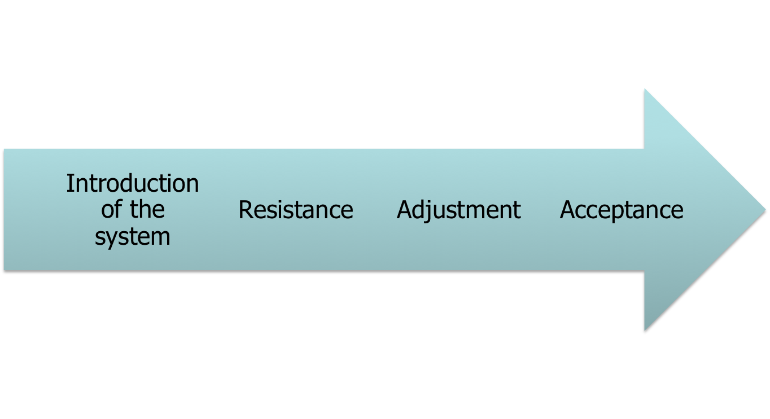
The introduction of information systems is a process consisting of several phases.
The ERM is much more than a piece of software – it is also about cultural change. – Gregory（2005)

Slide 18
Resistance
I think part of it was change, the main part, they were used to doing things their way. And, so they didn’t like anybody to change what they knew they had to do, they just wanted to go ahead and do it and be left alone.
--Interviewee7

Slide 20
Understanding users
Human issues are predominant, fundamental and challenging in the implementation of information systems.
Technophobia
Personality
Attitude towards change

Slide 21
Technophobia
The degree of tech-savvy remains a significant factor influencing users’ adjustment to the information systems.
I thought “well, if I make a mistake, someone is going to come and yell at me and I just deal with it and I [am] just going to be still and quiet”.
--Interviewee3

Slide 22
Personality
“[S]he was, she was skeptical, just because you know of the insecurities of you know, of, well the lack of confidence for herself…”
–Interviewee3
“I also think the intimidation factor is personal, whether someone’s competitive or not, whether a person is shy, …”
–Interviewee11

Slide 23
Attitudes toward change
They [who resisted the introduction of EDRMS] are from a generation from before computers, so they much prefer the more manual processes. And they much prefer the fact they had secretaries to do all of the filing work for them.
--Interviewee6
With me, I look at change as inevitable. I think whether or not we like it, we just have to go with the flow. So with that in mind, I try to keep an open mind.
--Interviewee14

Slide 24
Technology
ERMS must be user-friendly concerning a list of records management functionalities, including word processing, classification of records, cataloguing or registering of records, saving records, searching for and retrieving records, and distribution of records
-- Gunnlaugsdottir (2009)

Slide 25
Technology: functional customization
Customize the system to the business needs of different departments.

Slide 26
“Work around”
When individuals do not want to use the technology, or they have to go through painstaking process in order to properly use the technology, “they abandon it, or work around it, or change it, or think about changing their ends”
--Orlikowski, 2000, pp.323-324

Slide 27
Cheat-sheet
I had to cheat when I was new. I could not keep one motion type from the next straight in my head, so I had to put it in a Word document. … I had to do that at first because it was impossible, it was so much to learn, ... And so I don’t need it anymore of course, not for a while.
--Interviewee9

Slide 28
Types of Cheat-sheet
Reminder for actions that are complex and not used frequently
Short-cuts or a specific way of performing certain actions to make their use of the system more efficient
Personalized manuals to help users map what they learned at the training to their own work

Slide 29
Engaging users in the development and implementation of the system
The participation of expected users themselves in the development and adaptation of the system will greatly boost their acceptance of the system
The TMMIS – a “homegrown” system and a system being constantly improved based on users’ feedback and suggestions – seems more likely to win its audiences’ hearts.

Slide 30
Engaging users in the development and implementation of the system
The participation of expected users themselves in the development and adaptation of the system will greatly boost their acceptance of the system
The TMMIS – a “homegrown” system and a system being constantly improved based on users’ feedback and suggestions – seems more likely to win its audiences’ hearts.

Slide 31
A collaborative relationship is established between the general users and the development team of TMMIS, wherein the system development team constantly encourages general users to put forward suggestions, ideas or any change they would like to make to the system.

Slide 32
Information/Records specialists are part of the solution
Records management specialists can use their “holistic view” to facilitate the implementation of the information systems and serve as the interface between the information system and users’ actual work .

Slide 33
Training
You are sitting in a classroom working with, … fake files, and stuff, … that’s not pertinent to your own group…
--Interviewee5
So we were given training, and the focus was on the meeting portion, not so much on the bylaw part, which is I think a very specialized part of that system.
--Interviewee10

Slide 34
Training should be designed based on the varying business needs of the users, their IT competence, their learning curve, their learning styles, and their records management knowledge.
A focused training of the functions that the business departments use the most
Adjust the content and length of the training to the IT competence of the users
Desk-side training to reinforce what learned in the classroom
Records management principles and knowledge

Slide 35
Referencing materials
Manuals, guidelines, wikis, and other referencing materials are invaluable resources that users can refer after the training.

Slide 36
Gamification
Interviewees overall are interested to see gamification elements, but it has to be functional and relevant to their work.
Gamification elements can be used for motivation or for reward.
Using gamification to organize information and make them interesting and understandable to navigate.
Using gamification to calculate and display achievements

Slide 37
Other factors
Support by top management
Community learning
Pilot test

Slide 38
“Carrots” v.s. “Sticks”

Slide 39
Thank you!
Questions? Comments?
weimei.pan@ubc.ca

